Slide 1
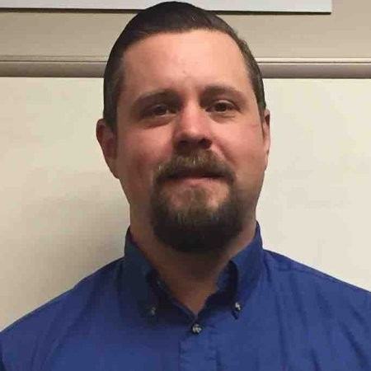
Welcome to the future of autonomy
Caleb Chain
Project Manager

Slide 2
Notes:
Our company was found by Bobby Hambrick in 2010 when he saw a gap in large industries such as many needed automotive sensors but could not get them.
Companies like Delphi would not sell sensors unless the customer bought 100,000 units.
In the beginning it was sales and support. We have now grown to integration, engineering, and software.
We have had strong growth over the years.
We have locations around the world to support our global customers.

Slide 3
Notes:
AutonomouStuff offers many solutions.
Product – we offer products in every area of autonomy. We have knowledgeable engineers that support these products.
Services – we offer many services to help get our customers started or moving along.
Software – We offer small software applications to help kick start our customers. Shuttle, Centering, Speed, Control, etc.
Platforms – We have by wire platforms that we have a lot of experience with and also work on many other platforms as well as customer platforms. Data Intelligence – All this data has to go somewhere. We can help our customer store this.

Slide 4
Notes:
AutonomouStuff has expanded globally to provide worldwide support to our customers. We are committed to leveraging our experience to stand behind those we work with and help them however we can.
Refer to map to explain location.
Integration is in Morton, SV, Germany, and China.

Slide 5
Notes:
We support more then just automotive. We are heavy in mining with the area we are in. We have worked with aerospace, maritime, railroad, and robotics. We help many universities and startups.

Slide 6
Notes:
We are heavy in the autonomous driving industry. Some of the top companies use our support.
We have equipment and software for 3D mapping, AI, Remote Control, Object tacking, etc.

Slide 8
Notes:
AutonomouStuff has built more automated driving research and development vehicles than any other company in the world Used in 12x countries in 4x different continents
USA, China, Canada, Israel, Korea, Australia, France, Germany, Taiwan, Japan, Italy, Qatar

Slide 9
Notes:
Talk about the sensors on the car.

Slide 11
Notes:
We strive to research & implement the latest product technologies to help you remain at the forefront of the industry.
Give examples of each product area,
3D – new stereo camera.
Actuation – Globe Motor
By Wire – PACMOD
Computing – Spectra
Data acquisition and storage – Quantum
Enclosures – APG
GPS – Novatel
Interface – Kvaser
Kits – AS kits, Apollo, etc
Lidar – Velodyne
Platforms – Lexus
Power Distribution – AS PDS
Radar – Delphi
Software – Our own
Ultrasonic – Neobotix
Vision – Flir
Wirless -

Slide 13
Notes:
We can offer services to help our customers take the next step or get started. We can help with engineering. We have many years of experience in integration of technology. We offer training on all of this. We off basic software and consulting/.

Slide 15
Notes:
Move to next slide but this will be the list.
Highway Automation – Lane Keeping, Passing, Adaptive Cruise Control
Object Processing – Lidar and Radar
Shuttle Automation – GPS waypoints
Speed and Steering – Your basics

Slide 16
Our software solutions
Notes:
Explain list.

Slide 19
U of I Gem E2

Slide 20
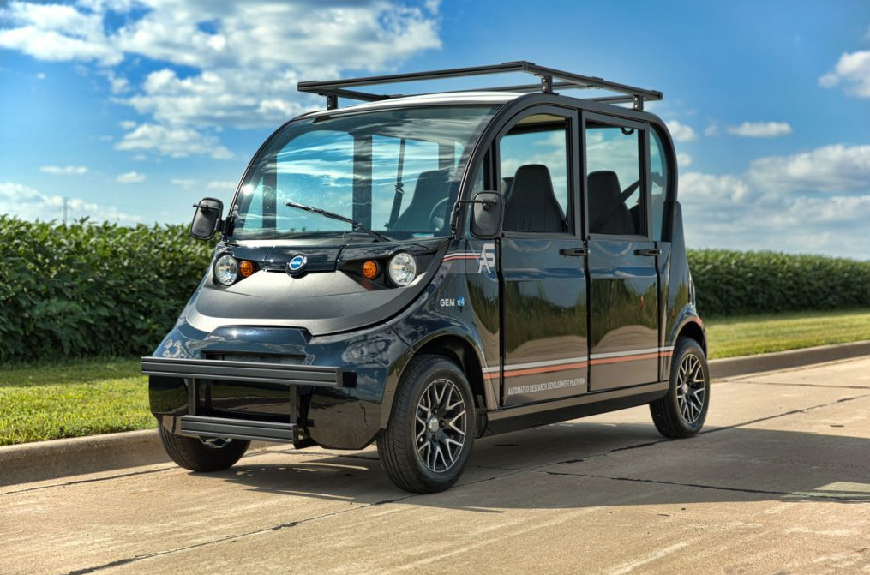
Automated Research Development Platform
Full set of software interfaces to the controls:
Steering
Braking
Acceleration
Software access:
Left and right blinkers
Reverse and drive gear selection
Speed feedback
Convenience features:
Dash mounted display screen
Game controller for by-wire testing
Power distribution terminals

Slide 21
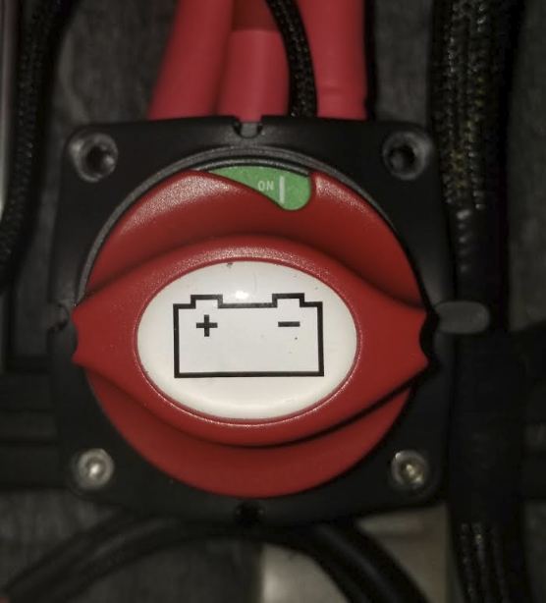
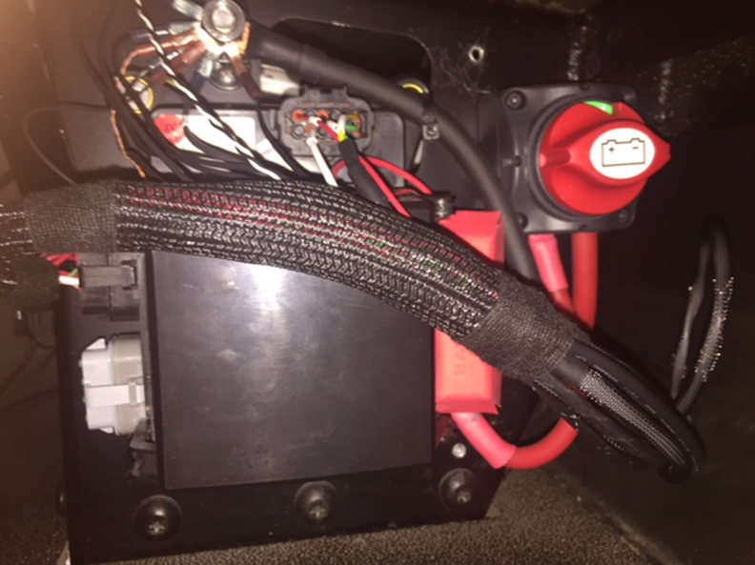
Master power switch
Switch will allow operator to cut power to Power Distribution System.
ON will supply Power to Power Distribution System from vehicle battery
OFF will remove Power to the Power Distribution System
Located under the driver’s seat.
ON
OFF

Slide 22
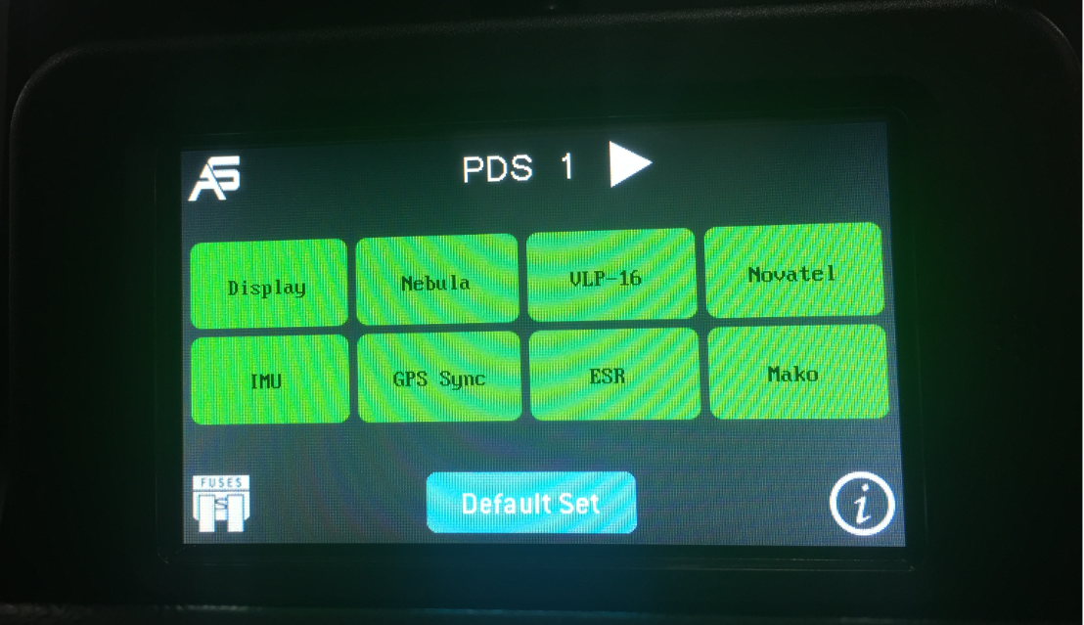
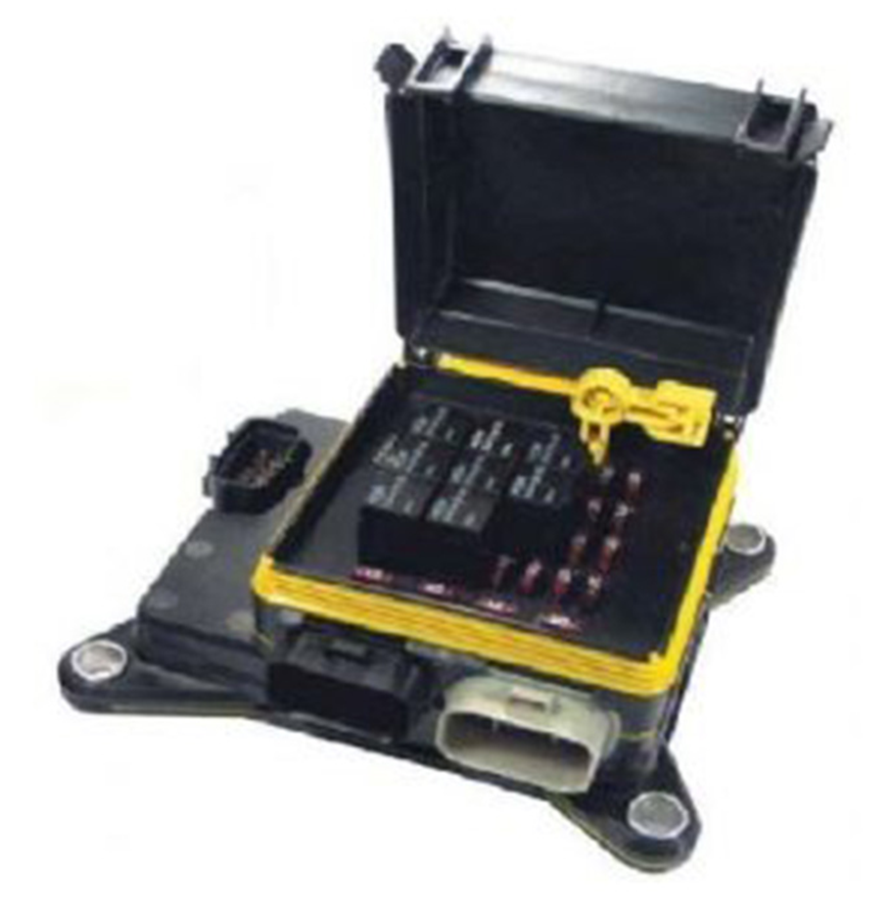
Power Distribution Switches
Touchscreen
(Located in front dash)
More info found here: https://autonomoustuff.atlassian.net/wiki/spaces/RW/pages/222724184/Configure+Channel+Names+on+AutonomouStuff+Power+Distribution+Touchscreen

Slide 23
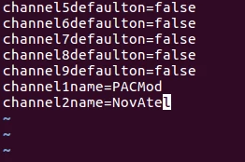
Power Distribution System
Programming
Connect an ethernet cable to the touchscreen. You will need to configure your computer to be on the same subnet as the touchscreen. The touchscreen's default IP Address is 192.168.150.15.
Download file from touchscreen
scp root@192.168.150.15:/.config/AutonomouStuff/AutonomouStuff-Dashboard.conf .
3. Modify the file to add channel#name entries using your text editor of choice.
4. Copy the conf file back to the Touchscreen.
scp AutonomouStuff-Dashboard.conf root@192.168.150.15:/.config/AutonomouStuff/AutonomouStuff-Dashboard.conf
5. Log into device and reboot
ssh root@192.168.150.15 reboot
More info found here: https://autonomoustuff.atlassian.net/wiki/spaces/RW/pages/222724184/Configure+Channel+Names+on+AutonomouStuff+Power+Distribution+Touchscreen

Slide 24
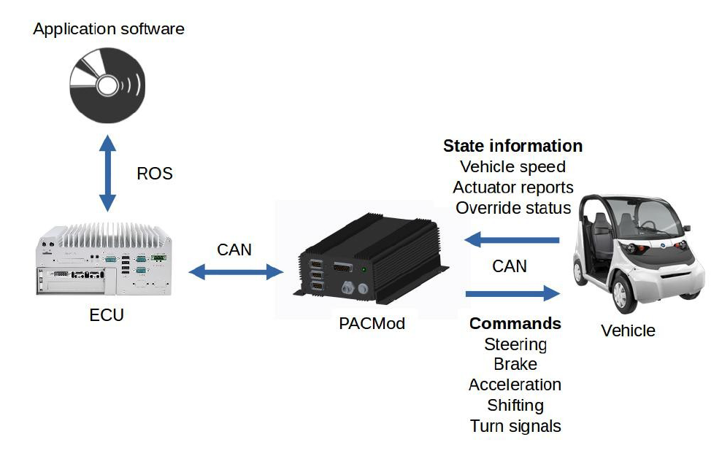
PACMOD

Slide 25
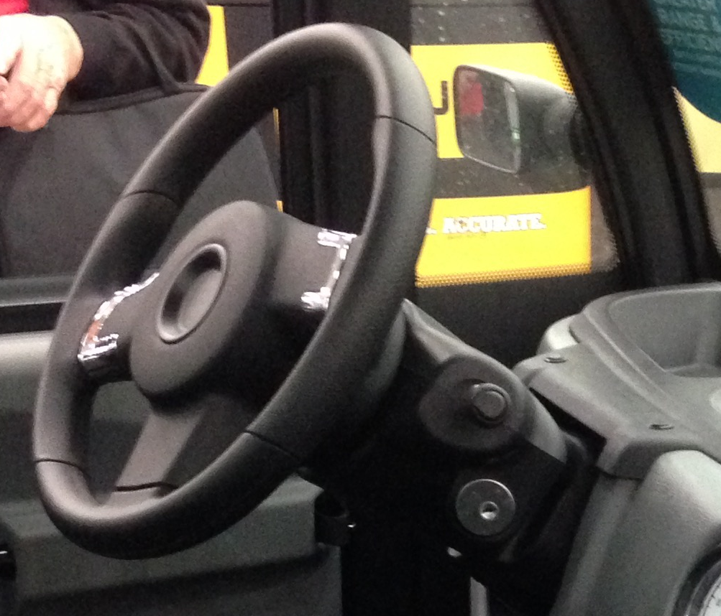
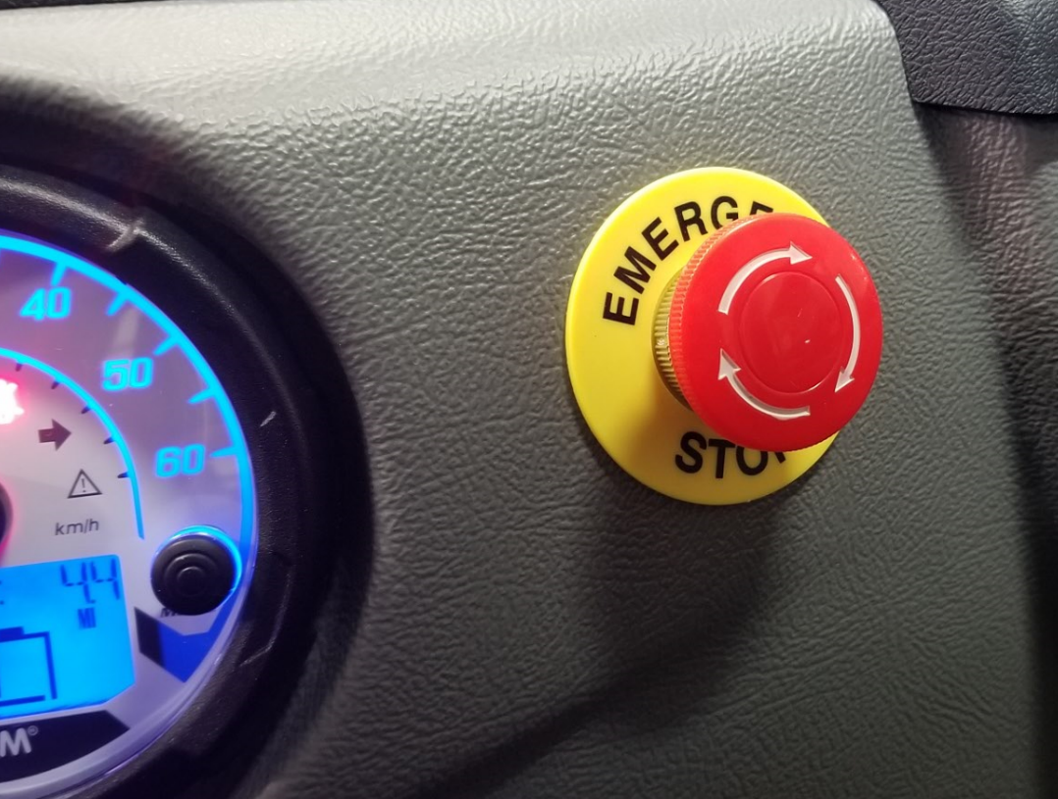
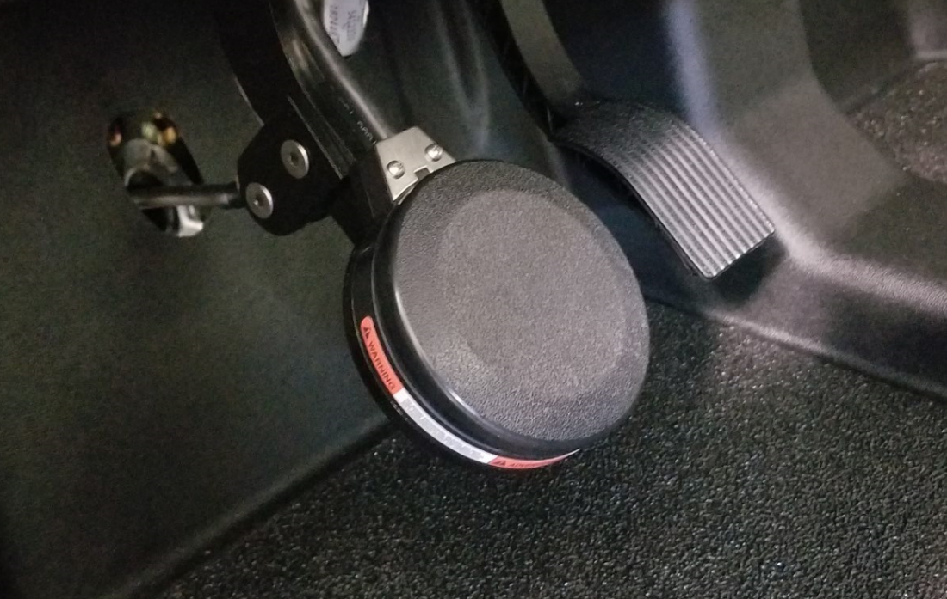
PACMOD Override
E Stop
(Only removes power to PACMOD and Steering Motor)
Steering
Brake/Throttle

Slide 26
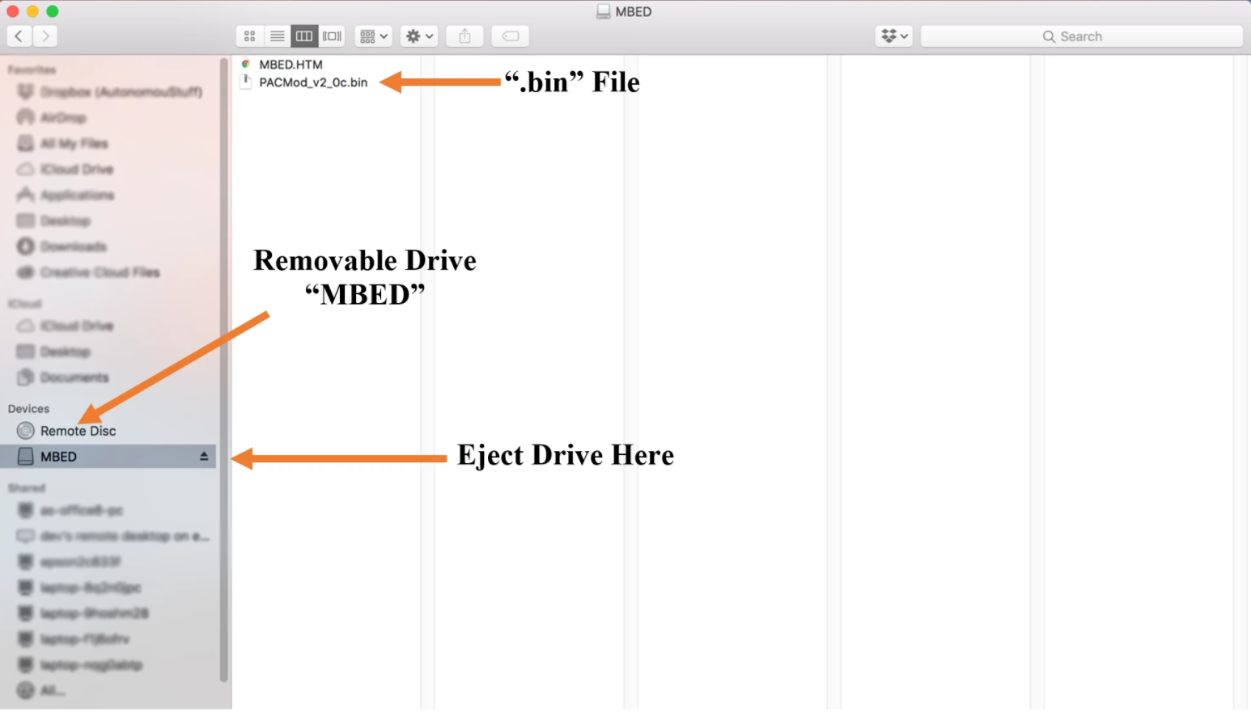
PACMOD Firmware Update
In the glovebox with the touchscreen locate the USB 2.0 B port.
The PACMod will show up as a removable drive entitled “MBED.” Replace the “.bin” with the most current one.
Reset the PACMod by power cycling it.
More Info found here: https://autonomoustuff.atlassian.net/wiki/spaces/RW/pages/17515801/PACMod+Firmware+Update+Procedure

Slide 27
Delphi ESR 2.5 firmware descriptions
24V ESR 2.5 firmware description
Auto-radiating
Does not require external input to starting radiating and outputting data
Shown to have greater stability over ethernet than the 12V unit
Multiple IP addresses available
Upon request prior to purchase
On-board 3-axis accelerometer data available over CAN bus
Data output (similar to 12V)
CAN bus:
Radar tracker grouping data (merging and filtering) over CAN bus
TCP over USB/Ethernet
Untracked, individual detection data
-10dBm detection threshold
Data less noisy than 12V unit
Notes:
The first column is similar to the 12V. The “less noisy” comment is what is typically observed. This is because Delphi has not determined what the actual dBm detection threshold really is, other than it is less than 10 dBm –due to this, the data on the 24V version actually looks like there’s less noise for the same detection/reflection sample.
The second column highlights the main points that differ between the 12 and 24V versions.

Slide 28
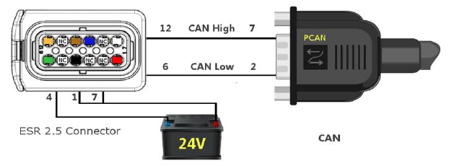
Delphi 24V ESR 2.5: CAN connection wiring
Connection routed from front rack mount to trunk via conduit
Terminated with 120 ohm resistor and DB9
Connected to Lumina via Kvaser PCI-e Card
2 separate CAN channels
PRVCAN (private)
VEHCAN (vehicle)

Slide 29
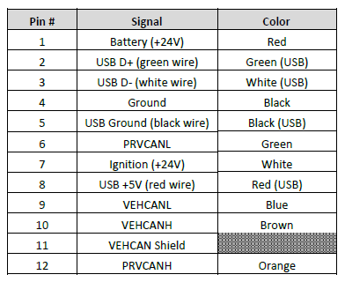
Delphi 24V ESR 2.5
CAN, USB/Ethernet connection wiring
Connection routed from front rack mount to trunk via conduit
USB to ethernet adapter installed and ethernet cable connected with RJ-45 termination
Connected to Lumina via either the onboard ethernet port or via ethernet (Control) switch

Slide 30
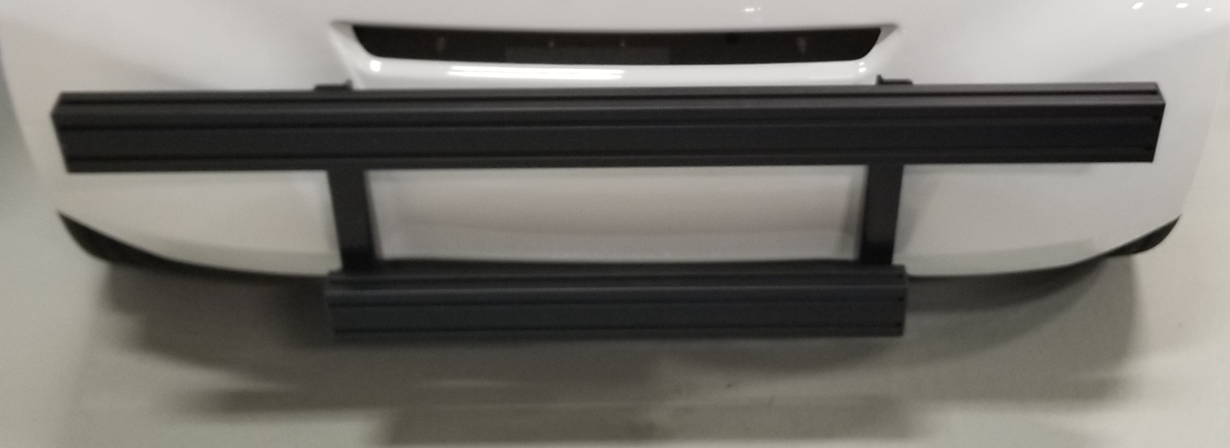
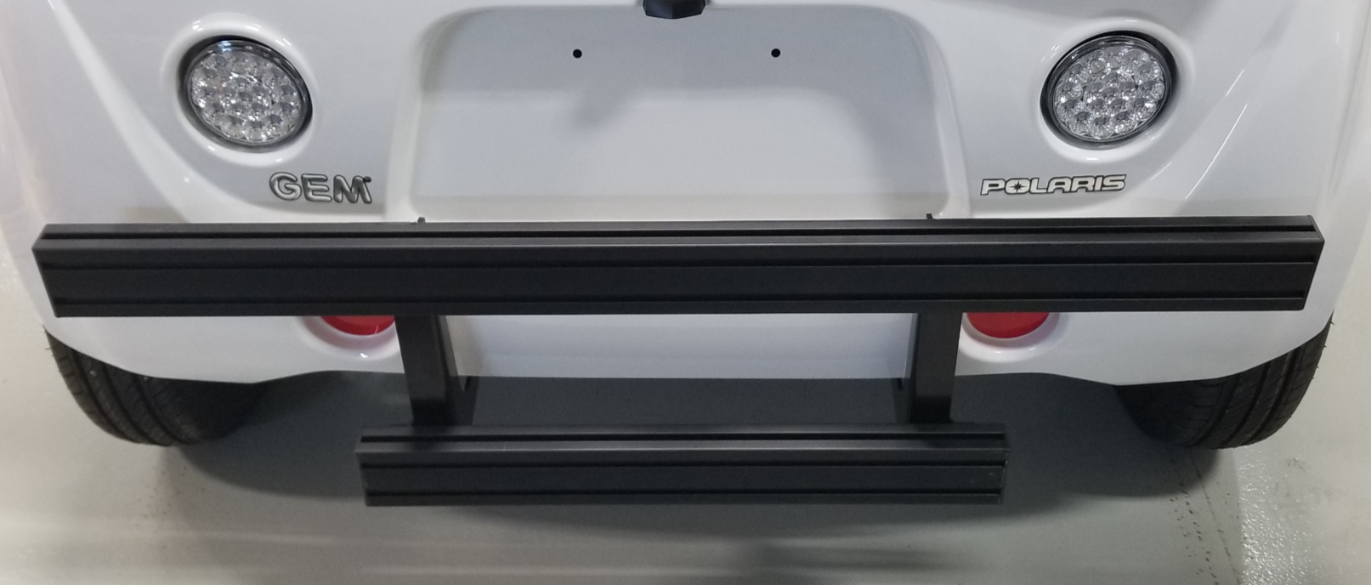
Automated Research Development Platform
Front and Rear Rack
All front and rear racks are made with 3 by 1.5 inch 15 series 80/20

Slide 31
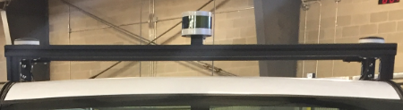
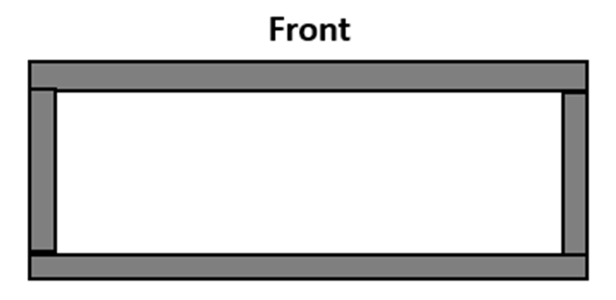
Automated Research Development Platform
Roof Rack
15 inches
51.25 inches
All roof racks are made with 1.5 by 1.5 inch 15 series 80/20

Slide 32
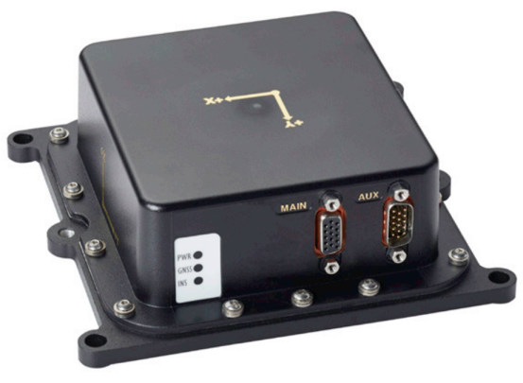
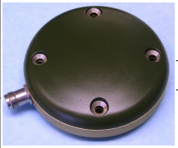
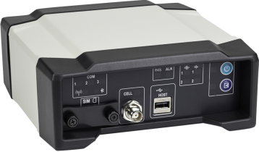
NovAtel
ProPak-6D1
Dual Antenna Support
Cellular
L1/L2 GPS+GLONASS
L-Band TerraStar-C PPP Corrections
-3 Grade IMUs
20 Hz Positions and Measurements
4GB Internal Memory
G5Ant-3AMT4
Matte black finish without branding
Various mounting options and connectors
Size: 89 mm dia. x 25 mm hgt
Weight: 368 g
IMU-IGM-A1/S1:
200Hz/125 Hz Inertial Measurements
Direct Wheel Sensor Support
Commercially Exportable
Small and lightweight design

Slide 33
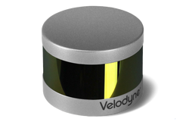
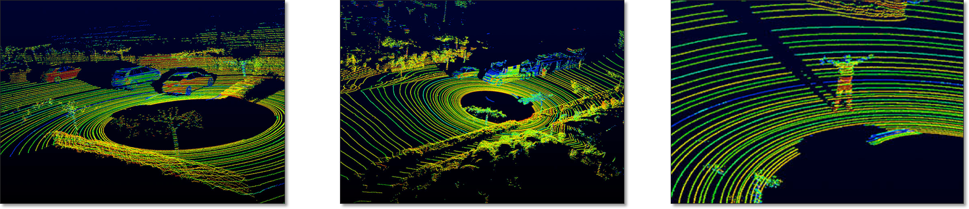
Velodyne LiDAR
360° Horizontal FOV
30° Vertical FOV
Multiple Channels
100-120meters
Dual Returns
Ethernet
VLP-16

Slide 34
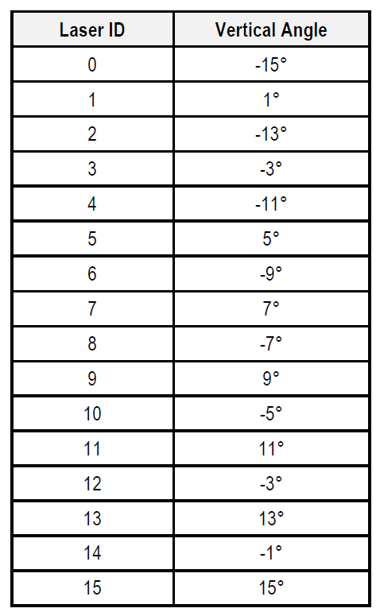
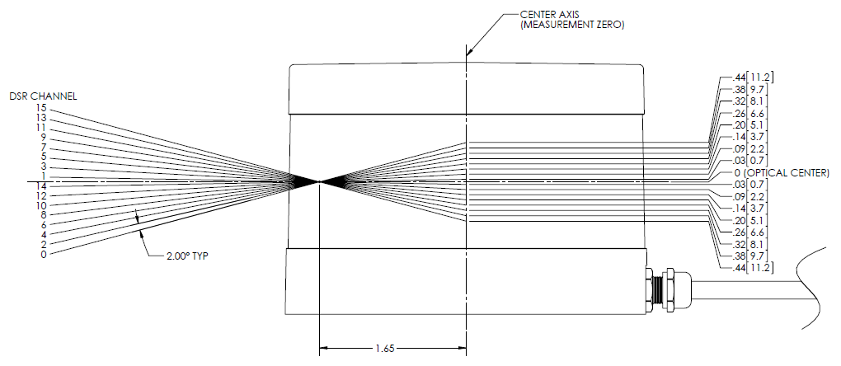
Velodyne LiDAR

Slide 35
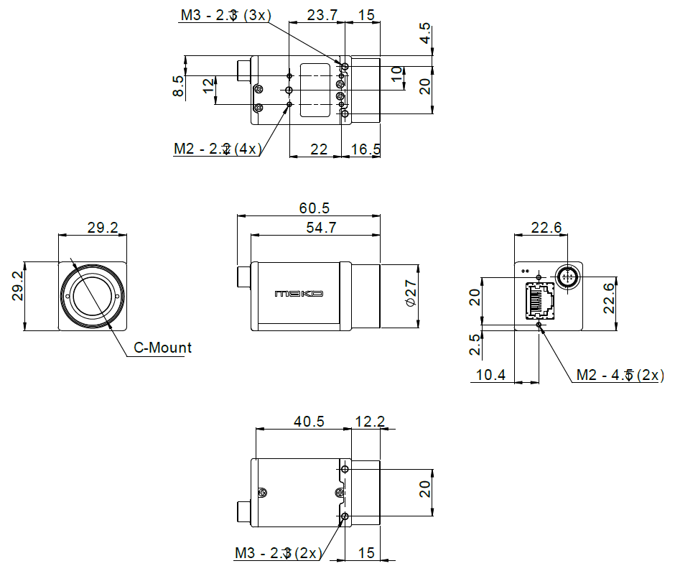
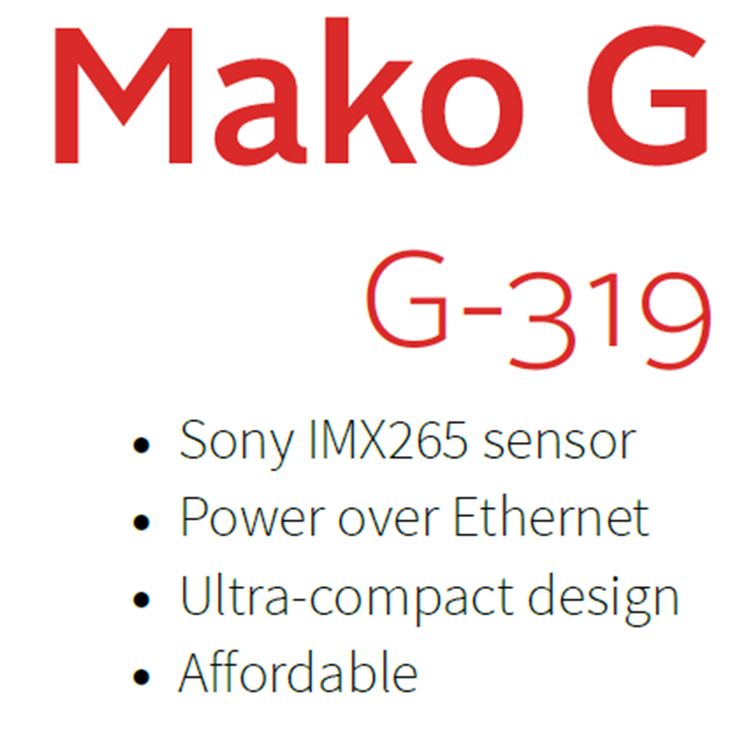

Allied Vision

Slide 36
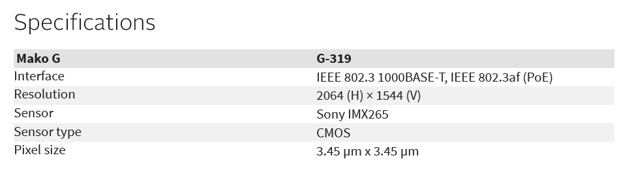
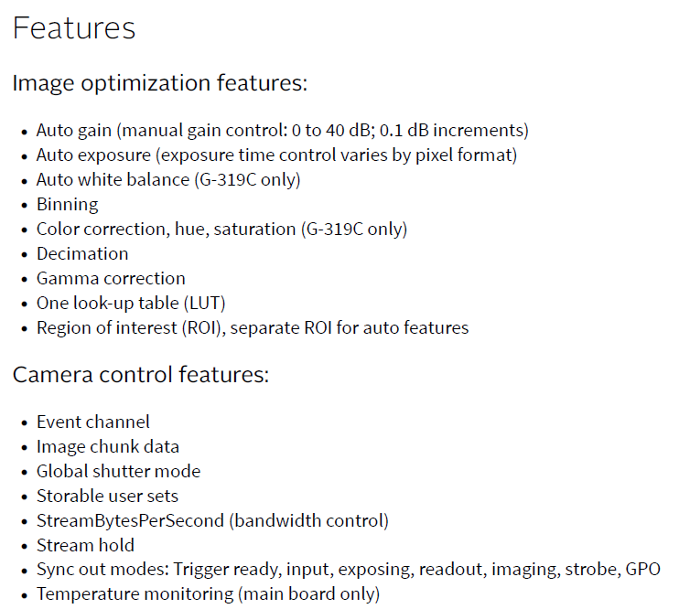
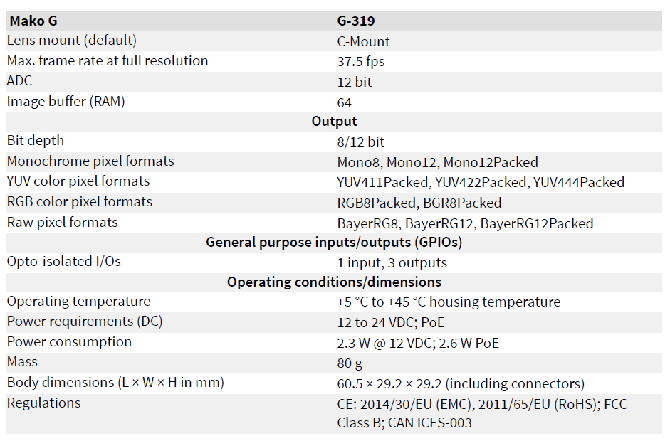
Allied Vision

Slide 37
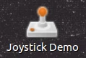
Joystick Demo
Desktop Icon
1) On the Ubuntu Desktop, locate the icon shaped like a joystick with the name "Joystick Demo"
2) Click on the icon and the demonstration will begin allowing you to control the vehicle with the provided Game Controller.
Terminal Window
Open a new Terminal ( Ctrl+Alt+t )
Launch the game control node with the following command:
roslaunch pacmod_game_control pacmod_game_control.launch
More info found here: https://autonomoustuff.atlassian.net/wiki/spaces/RW/pages/272859181/Run+the+PACMod+Game+Control+Demo

Slide 38
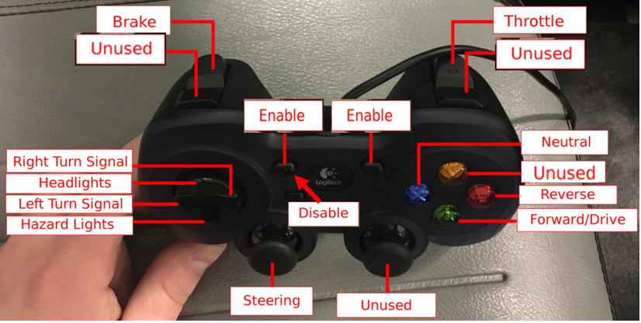
Joystick Demo
Controls
More info found here: https://autonomoustuff.atlassian.net/wiki/spaces/RW/pages/272859181/Run+the+PACMod+Game+Control+Demo

Slide 39
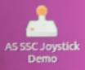
Speed and Steering Control demo
Desktop Icon
1) On the Ubuntu Desktop, locate the icon shaped like a joystick with the name “AS SSC Joystick Demo"
2) Click on the icon and the demonstration will begin allowing you to control the vehicle with the provided Game Controller.
Terminal Window
Open a new Terminal ( Ctrl+Alt+t )
Launch the game control node with the following command:
roslaunch pacmod_game_control pacmod_game_control.launch
More info found here: https://autonomoustuff.atlassian.net/wiki/spaces/RW/pages/272859181/Run+the+PACMod+Game+Control+Demo

Slide 40
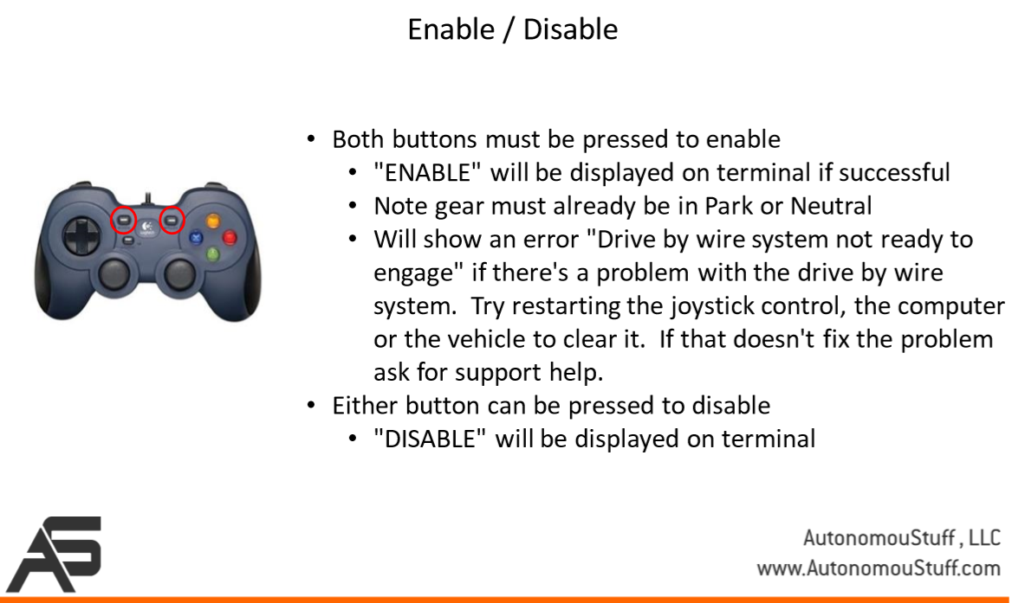
Speed and Steering Control demo

Slide 41
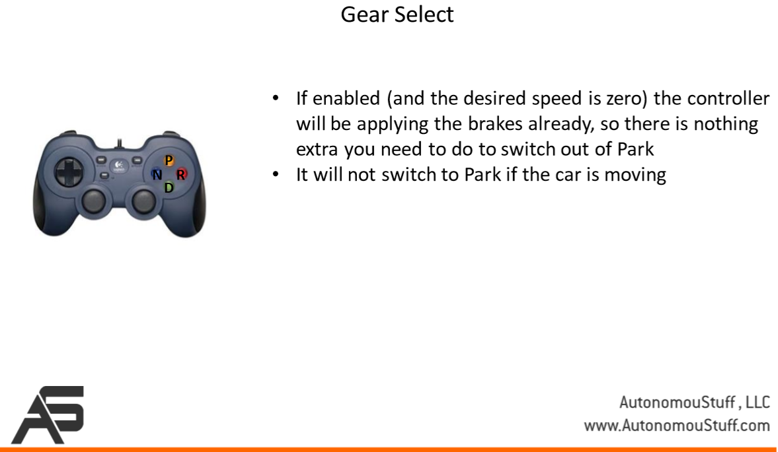
Speed and Steering Control demo

Slide 42
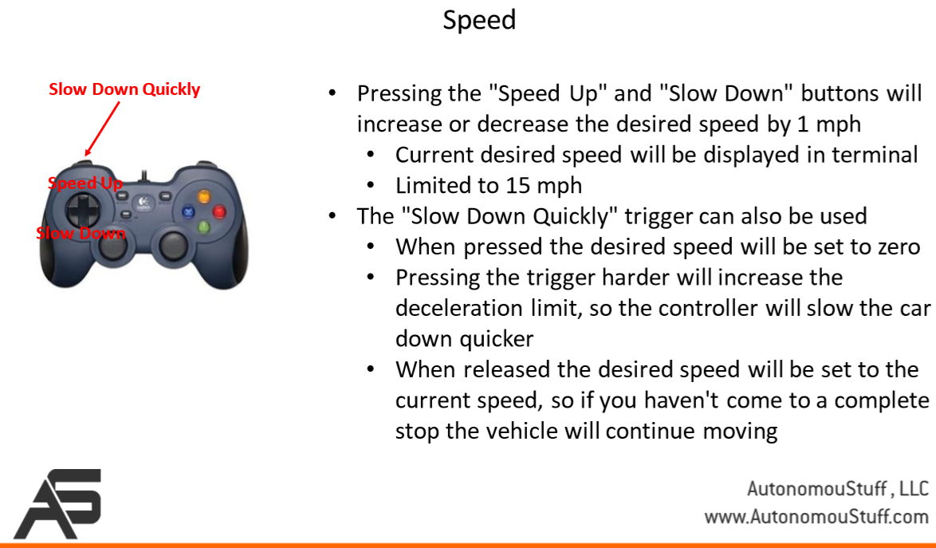
Speed and Steering Control demo

Slide 43
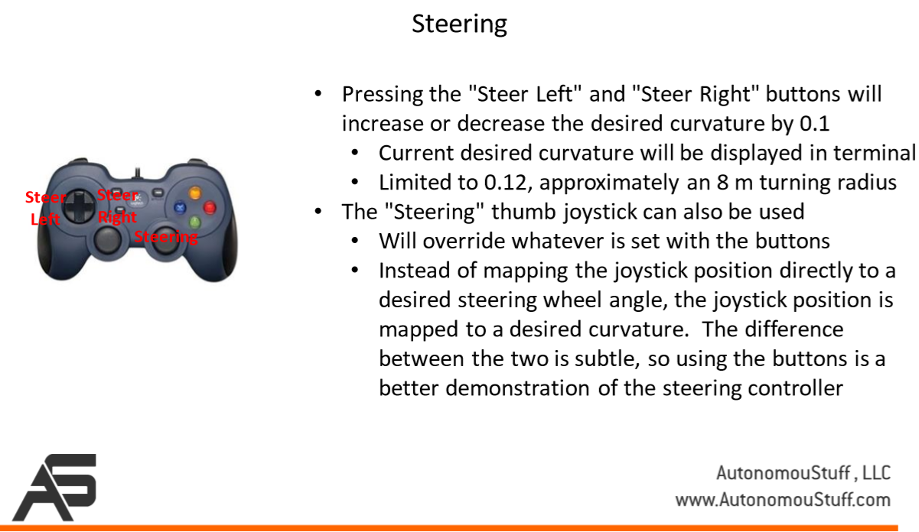
Speed and Steering Control demo

Slide 44
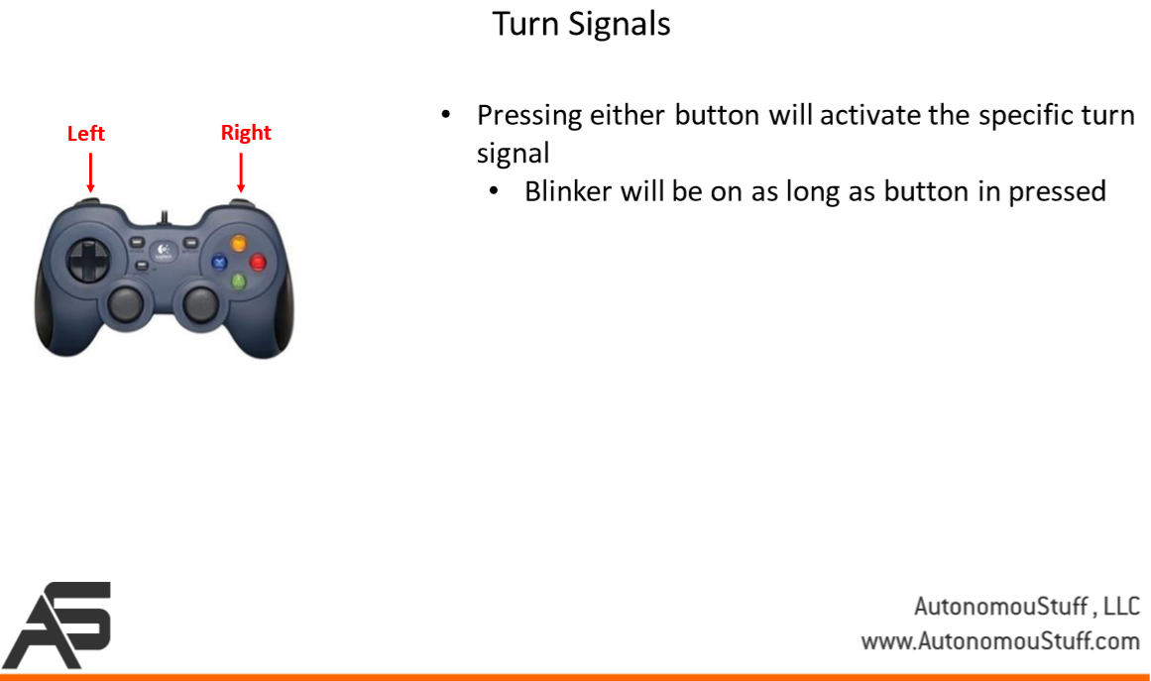
Speed and Steering Control demo

Slide 45
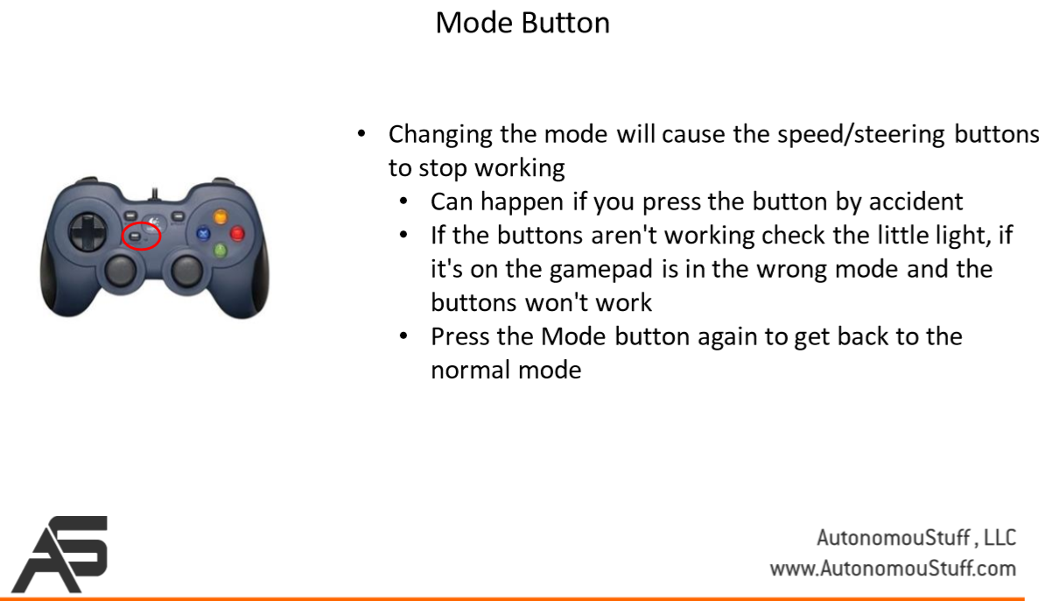
Speed and Steering Control demo

Slide 46
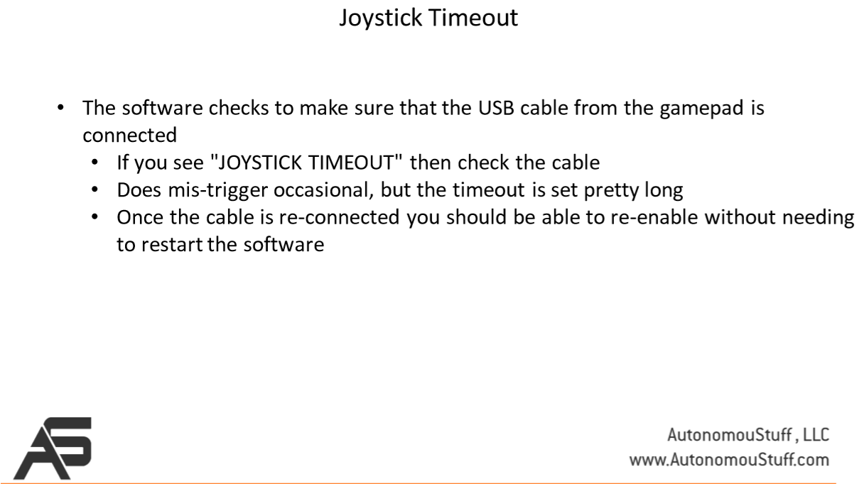
Speed and Steering Control demo

Slide 47
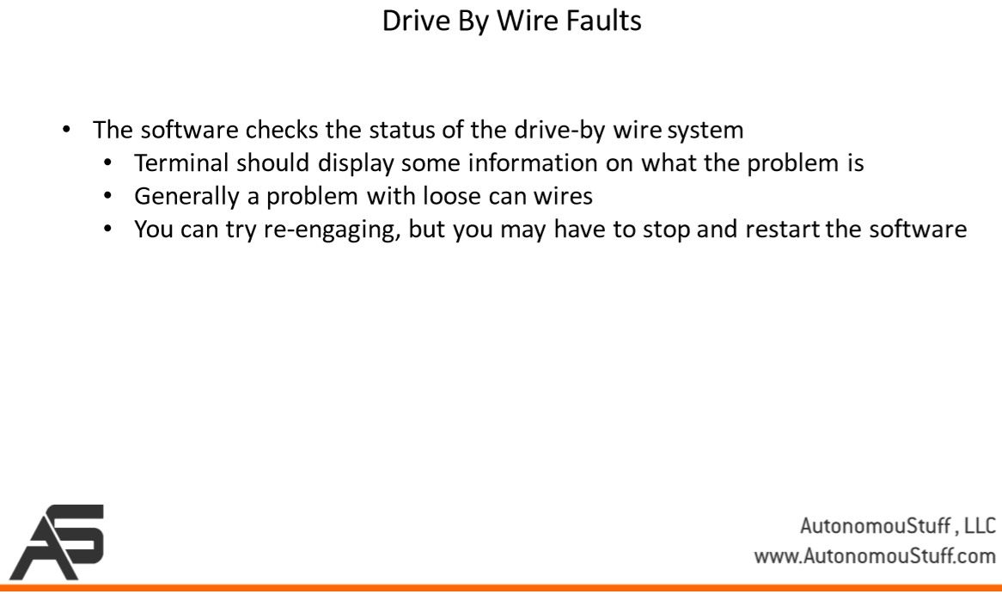
Speed and Steering Control demo

Slide 48
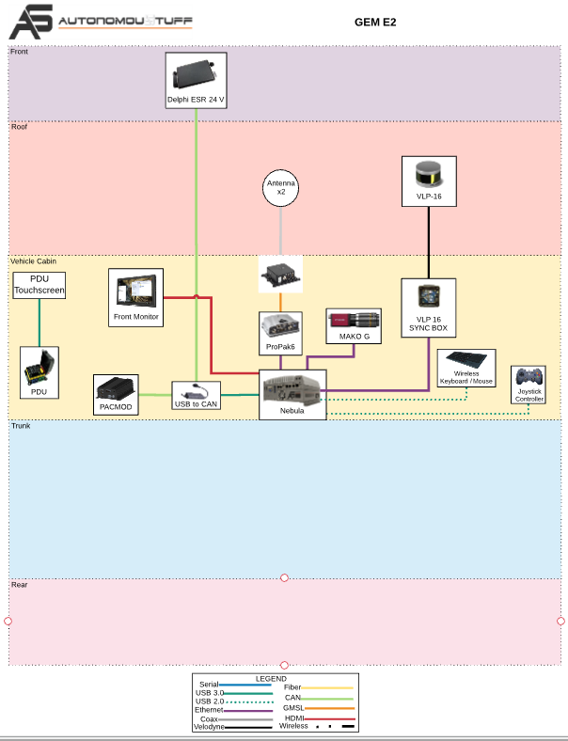

Slide 49
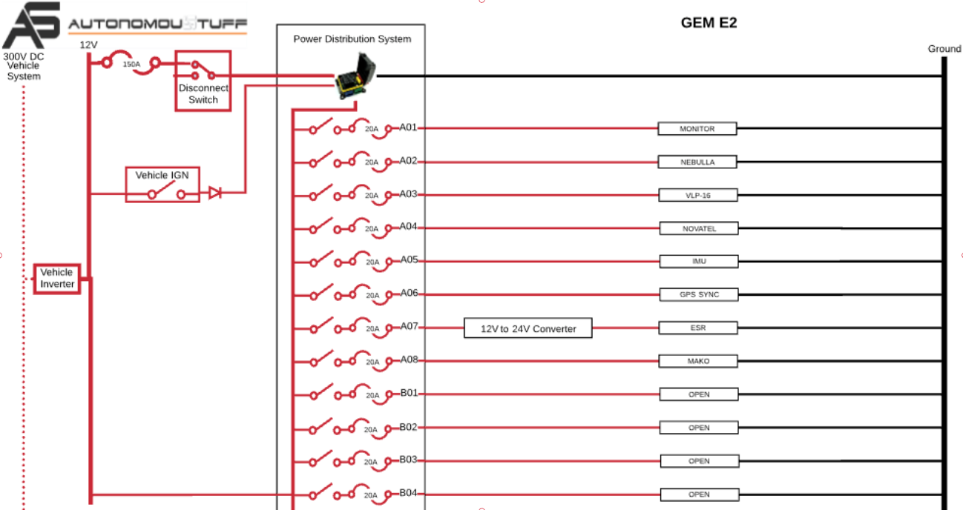

Slide 50
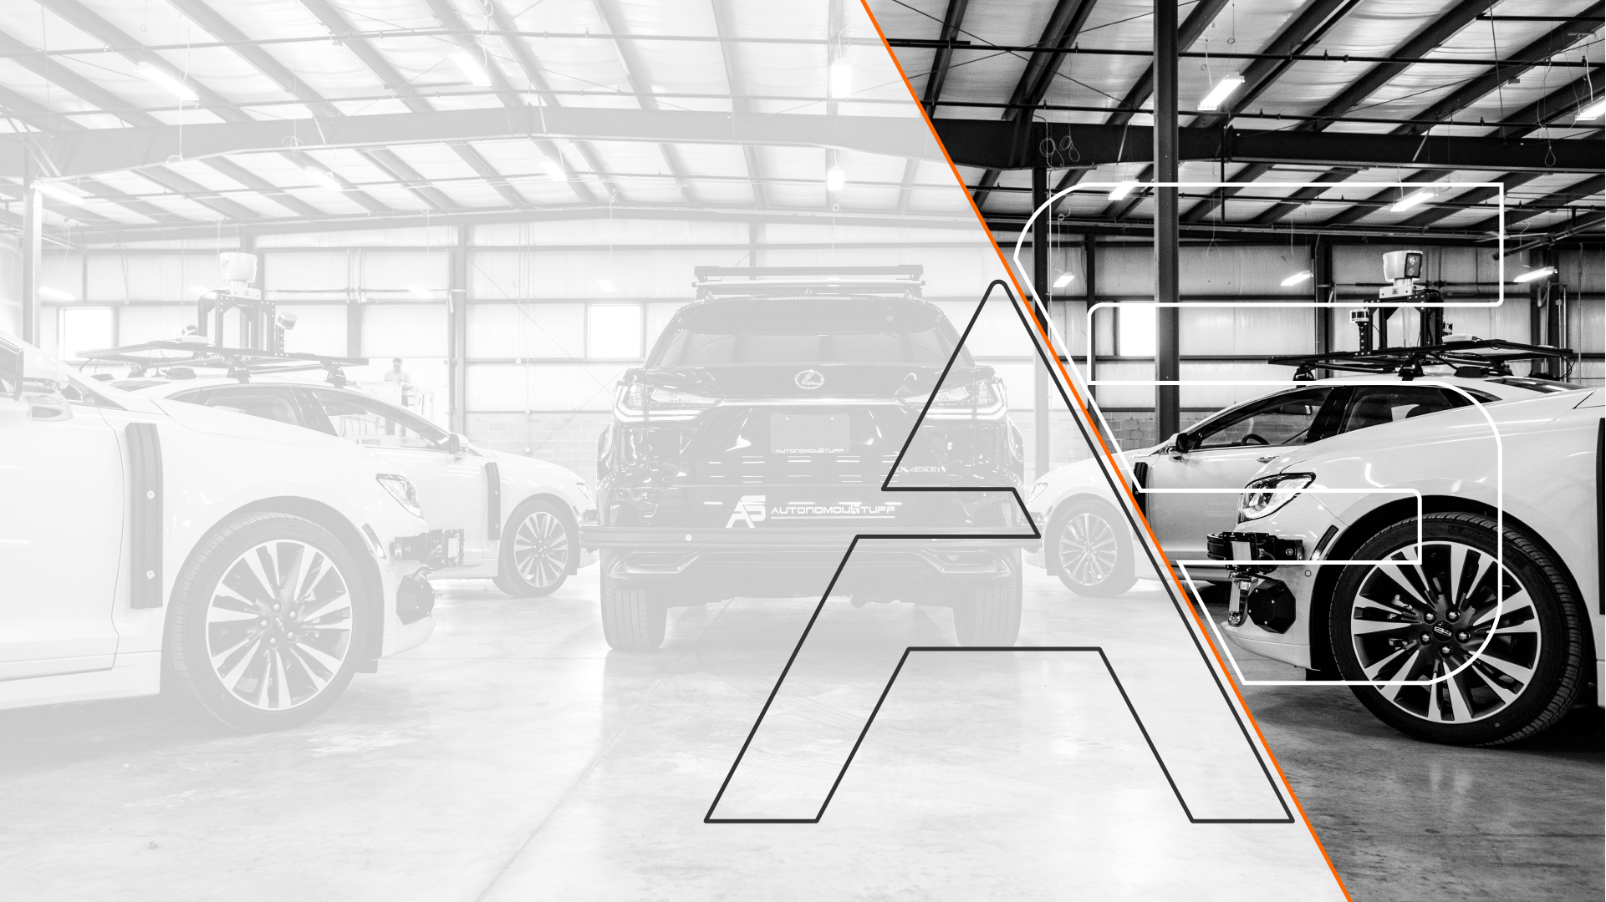




Contact information
Caleb Chain
T: 309.291.0966
M: 309.229.1614
cchain@AutonomouStuff.com
www.AutonomouStuff.com
@AutonomouStuff
@AutonomouStuff
AutonomouStuff, LLC
AutonomouStuff, LLC

